Slide 1

Chapter 12 Business Plan Preparation for New Ventures

Slide 2
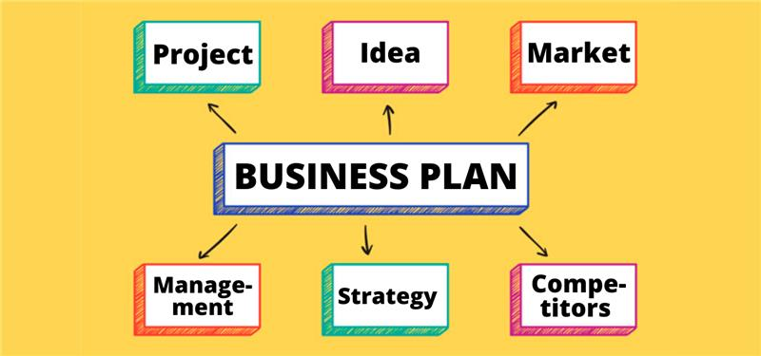

Slide 3
The most effective businesses emerge from a process that includes
Recognizing a business idea (convert into opportunity)
Testing the feasibility of the idea
Writing a business plan (We are here)
Launching the business

Slide 4
What is a business plan ?
A written document.
Typically of 25 to 35 pages.
Describes what a new business intends to achieve
How it intends to accomplish the goal.

Slide 5
Common Errors Committed by Entrepreneurs While Making a Business plan
No realistic goals.
Failure to anticipate roadblocks.
No commitment or dedication.
Lack of demonstrated experience.
No market niche.

Slide 6


Slide 7
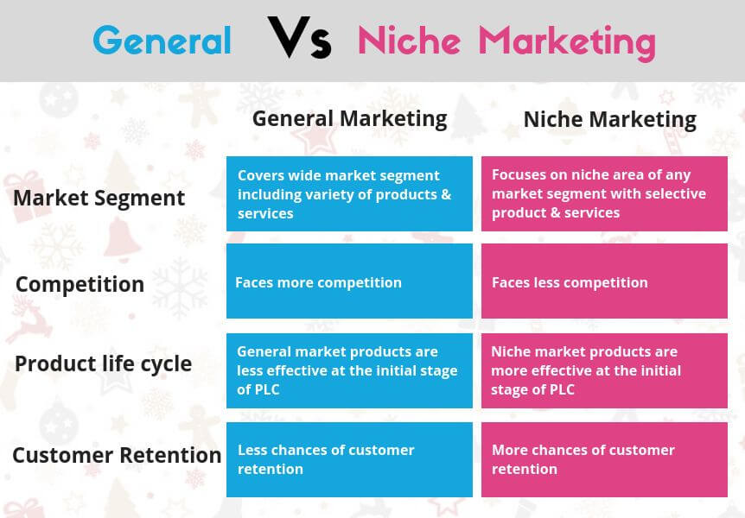

Slide 8

Wait! Don’t write a business plan.
Don’t write business plan too early.
Must have sufficient details

Slide 9
What is the purpose of business plan ? benefits
The business plan must be substantive enough and have sufficient details about the merits of the new venture to convince the reader for his support.
Business plan forces the management to think through every aspect of its business and agree on its most important priorities and goals.
One academic study : potential entrepreneurs who completed a business plan were 6 times more likely to start a business than ….

Slide 10
Discuss 2 primary reasons for writing a business plan ? benefits
For new ventures
Reason 1 (Internal Reason)
the firm (it helps to develop a road map to follow to execute its strategies / plans)
Forces the founding team to systematically think through every aspect of their new venture
Reason 2 (External Reason)
Outside the firm (for potential investors & other stake holders)
Communicates the merits of a new venture to outsiders, such as investors and bankers.
Also called “Selling Document of the Company”

Slide 11

Is it possible for the entrepreneur to generate capital through outsiders if there is no business plan ?
If well defined business plan then you are like him
If the plan is incomplete or looks sloppy, it is easy for an investor to infer that the venture itself is incomplete and sloppy.

Slide 12

Is it possible for the entrepreneur to generate capital through outsiders if there is no business plan ?
If no business plan then you are like him
If the plan is incomplete or looks sloppy, it is easy for an investor to infer that the venture itself is incomplete and sloppy.

Slide 13
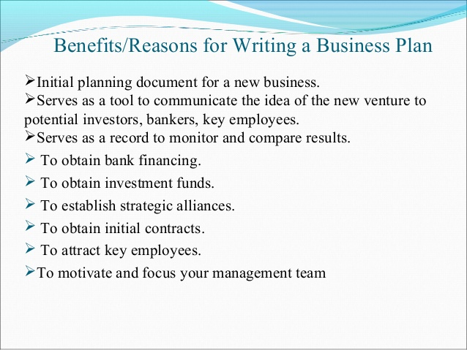

Slide 14
Who reads a business plan and what they are looking for ? benefits
There are 2 primary audience :
A Firm’s Employees
Vision and future plans of a firm.
A clearly written plan also helps a firm’s employees (different cadre) to operate in sync and move forward in a consistent and purposeful manner.
Newly hired senior management by reading business plan gets confirmation about the overall company plans and direction of the company.
Investors and other External Stakeholders
First show business idea and then feasibility analysis.
Second show the business plan.
Sophisticated investors, potential business partners and recruits will base their assessment of the future proposal prospects of a business on factor not on guesswork.
Also disclose all resource limitations the business must meet before it is ready to start earning revenues.
Require capital to buy equipment or hire highly talented work force.

Slide 15
Questions to be answered by your business plan
Is your plan organized (appearance do count).
Is your product / services and business mission clear and simple?
Are you focused on the right thing?
Who is your customer?
Why will customers buy?
Do you have a competitive advantage?
Do you have a favorable cost structure?
Can the management team build a business?
How much money do you need?
How does your investor get a cash return?

Slide 16
Outline of the Business Plan First “Cover Page” then “Table of Contents”
Executive Summary (if executive summary is convincing only then ask for full business plan)
Short overview of the entire business plan
Company Description
Company history
Mission statement
Products and services
Current status
Legal status and ownership
Key key partnerships (if any)
Industry Analysis
Industry size, growth rate, and sales projections
Industry structure
Nature of participants
Key success factors
Industry trends
Long term prospects
Market Analysis
Market segmentation and target market selection
Buyer behavior
Competitor analysis
Marketing Plan
Overall marketing strategy
Product, price, promotions, and distribution
Management Team and Company Structure
Management team
Board of Directors
Board of Advisers
Company Structure
Operations Plan
General approach to operations
Business location
Facilities and equipment
Product (or Service) Design and Development Plan
Development status and tasks
Challenges and risks
Intellectual property
Financial Projections
Sources and uses of funds statements
Assumptions sheet
Pro Forma Income statements
Pro Forma Balance Sheets
Pro Forma Cash Flows
Ratio Analysis

Slide 17
What to write in company Description Section ?
Company history
From where the idea for the company came.
Driving force behind its inception.
If it is a startup then must mention.
Mission statement
Why a company exists
What it aspires (dream) to become
Defines the path (financial / moral)
Products and services
How your products / services are unique
How to position (relative to its competitors) this in the market
Current status (explain through milestones)
Development stage (where your company is at this time ….)
Important milestones
Registered your company’s name
Completed a feasibility analysis
Written a business plan
Established a legal entity
Legal status and ownership
Current form of business ownership (partnership / private limited)
Key partnerships (if any)
Partnership with other companies to make your company work in competitive world.

Slide 18
Type of Partnership that are common in Business Plan
Smaller companies partnering with larger companies
to bring their products to market.
to produce, fulfill, and / or ship their products.
Outsourcing Human Resources Management

Slide 19
Industry Analysis (before a business selects its target market, it should have a good grasp in its industry)
Industry size, growth rate, and sales projections
Promising areas of this industry
Points of vulnerability
Industry structure
How concentrated / fragmented
Fragmented industries are more receptive to new entrants than industries that are dominated by a handful of a large firms.
Nature of participants (companies)
Are the industry participants innovative or conservative
Key success factors
6-10 key factors (must be competent to compete)
Then differentiation.
Industry trends
Economic trends / social trends / technological trends / political & regulatory changes
Long term prospects
What are the trends
What you belief (as an entrepreneur)

Slide 20
Market Analysis
Market segmentation and target market selection
Dividing the market into distinct segments
Geographic (city / country)
Demographic (age / gender / income)
Psychographic (personality / lifestyle / values)
Buyer behavior
Competitor analysis

Slide 21
Marketing Plan
Overall marketing strategy
How it differentiates
Guidance for how the company should reach it s target markets via (4PCs)
Product, price, promotions, and distribution (sync with differentiation)

Slide 22
Management Team and Company Structure (investors first executive summary and then go directly to this section)
Management team
Brief profile of each member
Position (title)
Duties / responsibilities
Previous industry / related experience
Previous successes
Educational background
Board of Directors (Legal responsibilities)
Board of Advisers (No legal responsibilities)
Company Structure
Organizational chart (graphical representation of authority / responsibility)

Slide 23
Operations Plan (3-4 pages) (how the business will be run) (what could be break / make issues)
General approach to operations
Business location
Facilities and equipment

Slide 24
Operations Plan (3-4 pages) (how the business will be run) (what could be break / make issues)
Back Stage (Behind the Scenes Activities )
Front Stage (What the Members See)
Staff selection
Operations manual
Relationship with suppliers
Relationships with govt.
Development of marketing materials
Employee orientation and training
Emergency plans
Member tours
Operating hours
Staff assistance
Fitness classes and programs
Fitness machines
Workshops
Monthly newsletter

Slide 25
Product (or Service) Design and Development Plan
Development status and tasks
If developing new products / services then must mention
What are your development efforts
Details of logical path of that new product development
timelines
Challenges and risks
Intellectual property

Slide 26
Financial Projections
Sources and uses of funds statements
How much money a firm needs
Where the money will come from
What the money will be used for
Assumptions sheet
Pakistan population is going to be increased by 3% annually
Sales projections are based on this population growth
Pro Forma Income statements (future not past – 3 to 5 years)
Pro Forma Balance Sheets (future not past – 3 to five years)
Pro Forma Cash Flows (future not past – 3 to five years)
Ratio Analysis
Return on assets
Return on sales

Slide 27
The 10 most important questions a business plan should answer
Is the business just an idea / opportunity with real potential.
Is the product / service viable (add significant value to customer) (feasibility analysis completed ? ) (Results ? )
Business entering into exciting / growing industry (has the firm found any attractive position)
Business has well defined target market ?
Does the business has points of differentiation ?
Does the business has sound marketing plan ?
Is the management team experience / skilled to launch a new firm ?
Is the business’s operations’ plan appropriate and sound ?
Assumptions (financial on realistic grounds ) ?
Financial projections completed correctly (is bright future of the firm ) ?

Slide 28
Elements of a business plan (section 1-4)
Section 1: Executive Summary
Section 2: Business Description
General description of the business.
Industry background
Goals and potential of the business and milestones (if any)
Uniqueness of product or service.
Section 3: Marketing
Research and Analysis
Target market (customers identified)
Market size and trends
Competition.
Estimated market size.
Marketing Plan
Market strategy – sales and distribution.
Pricing.
Advertising and promotions.
Section 4: Operations
Identify location : advantages
Specific operational procedures
Personnel needs and uses
Proximity to suppliers.

Slide 29
Elements of a business plan (section 5-8)
Section 5: Management
Management team – key personnel.
Legal structure – stock agreement, employment agreement, ownership.
Board of Directors, advisors, consultants.
Section 6: Financial
Financial forecast.
Profit and loss.
Cash flow.
Break even analysis.
Cost controls.
Budgeting plans.
Section 7: Critical Risks
Potential problems.
Obstacles and risks.
Alternative courses of action.
Section 8: Harvest Strategy
Liquidity event (IPO or sale)
Continuity of business strategy.
Identify successor.

Slide 30
Elements of a business plan (section 9)
Section 9: Milestone Schedule
Timing and objectives.
Deadlines and milestones.
Relationship of events.

Slide 31
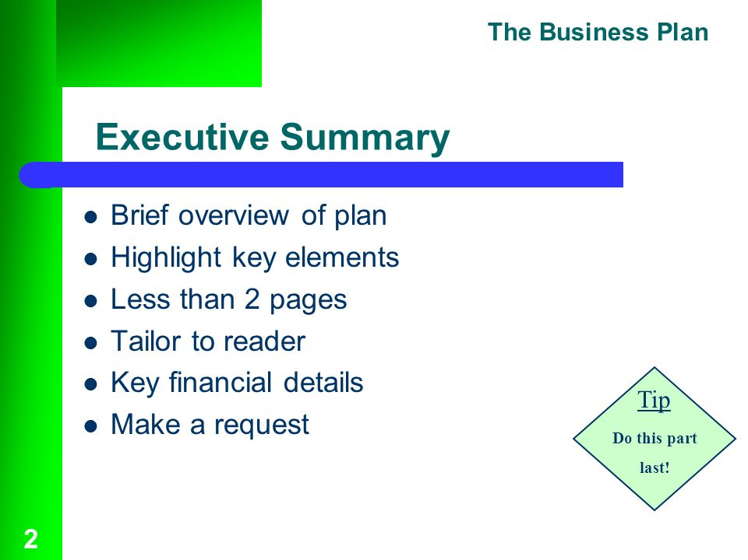

Slide 32
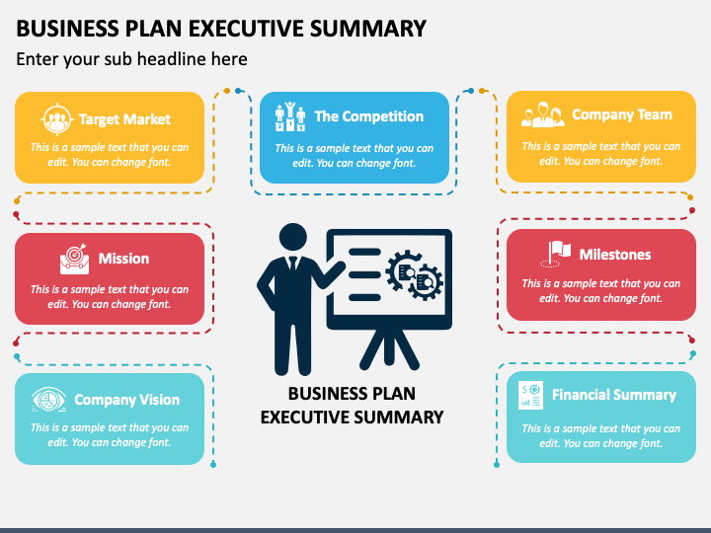

Slide 33
Critical risk segments
Effects of unfavorable trends.
Design or manufacturing costs that have gone over estimate.
Difficulties long lead times while purchasing parts of materials.
Unplanned for new competition.
Delays.
Inaccurate projections.
Industry slumps.

Slide 34
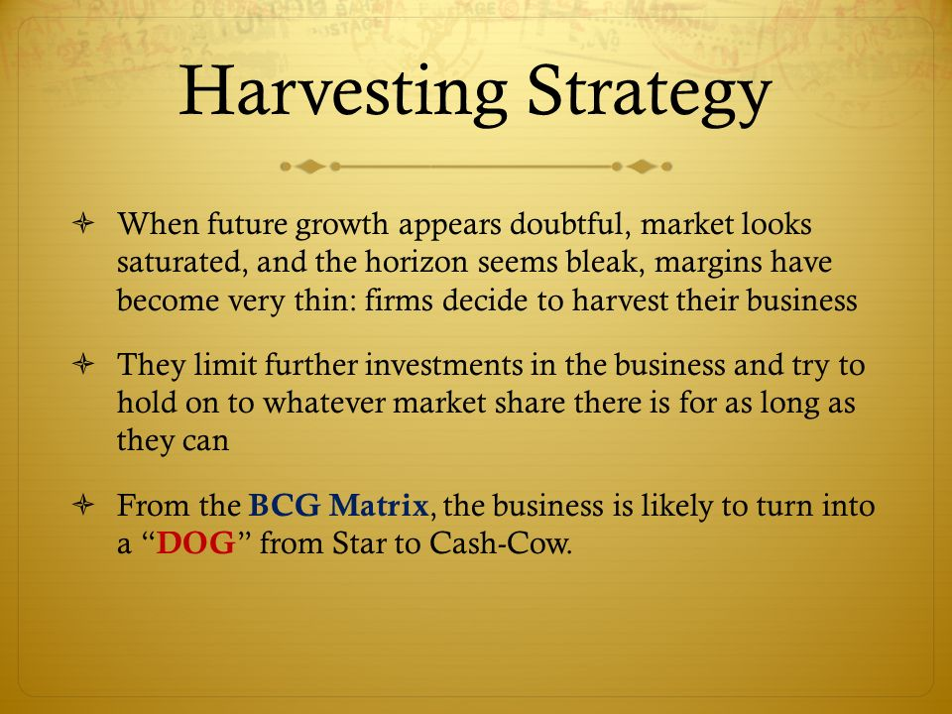

Slide 35
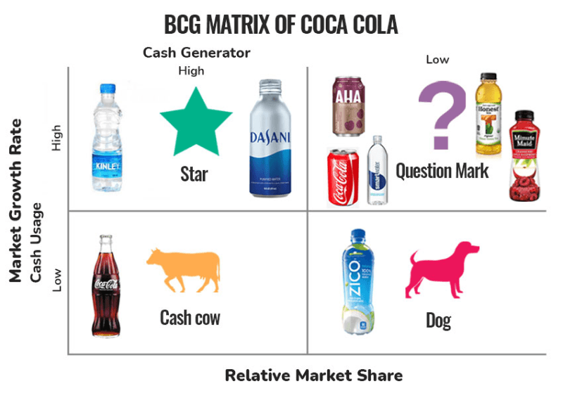

Slide 36
Milestone Schedule Segment
Incorporation of the venture.
Completion of design and development.
Completion of prototypes.
Hiring of sales representatives.
Product display at trade shows.
Singing up distributors and dealers.
Ordering production quantities of materials.
Receipts of first orders.

Slide 37
Common business planning mistakes while making a business plan
Overall mistakes
Entrepreneurs are unable to clearly articulate their vision in the plan.
They are failed to provide sufficient details regarding the implementations of their strategy.
They ineffectively present the goals and objectives which are most important to the business and success.
They do not convincingly present the basis for their strategy.
They do not improve their plan based on the feedback from investors.
Executive summary.
They do not precise about their needs and capabilities.
They waste words with fillers and superfluous information.
Management.
They forget to include their previous successes and or failures.
They dismiss the importance investors place on an experienced management team.
Marketing.
They rely heavily on secondary market research rather than soliciting the opinions of their potential customers.
They claim the percent of the market their company will own without research support.
Financials.
They overlook and in turn underestimate their cash flow requirement.
They inflate or underestimate their margins in order to arrive at their ideal profitability.

Slide 38
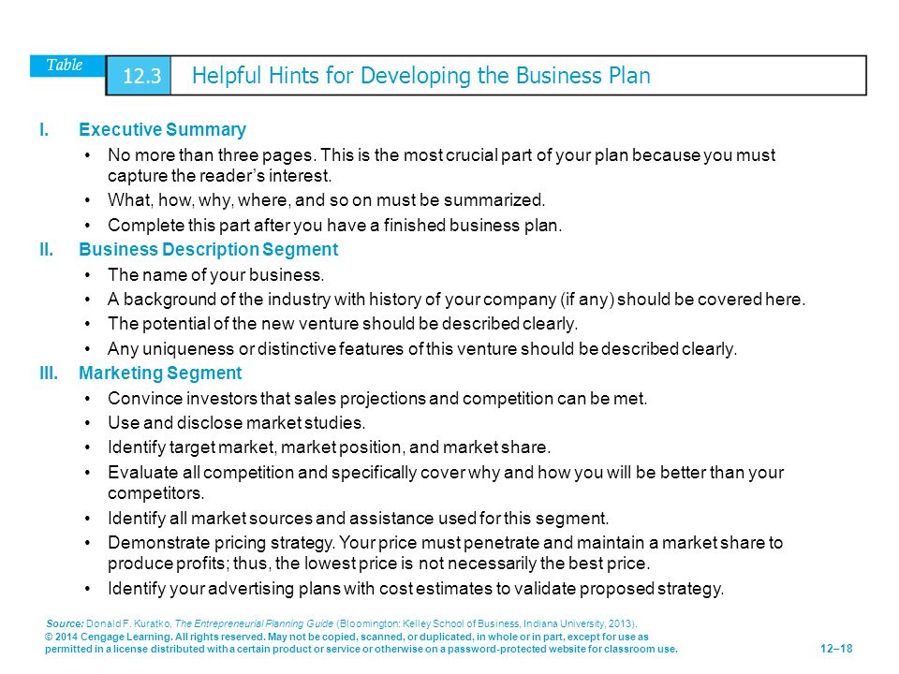

Slide 39
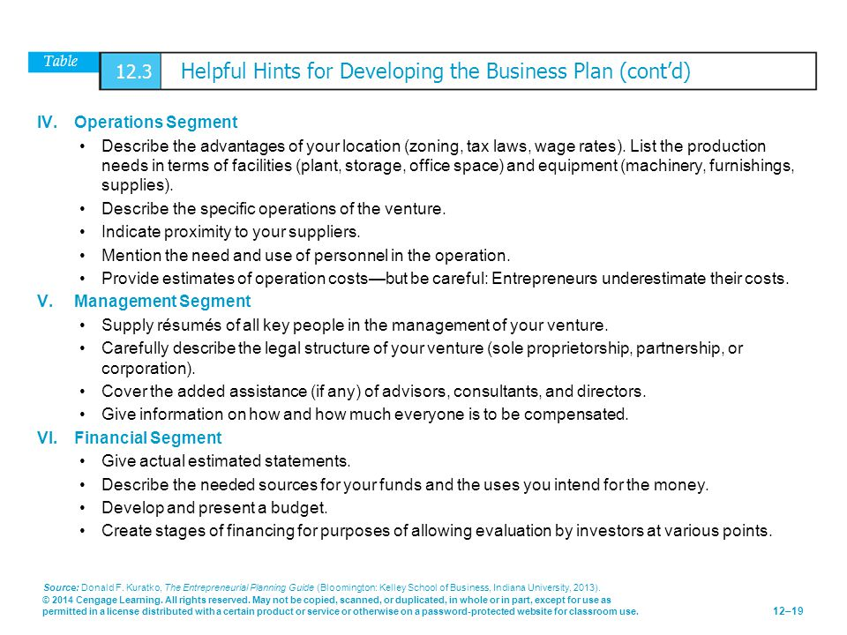

Slide 40
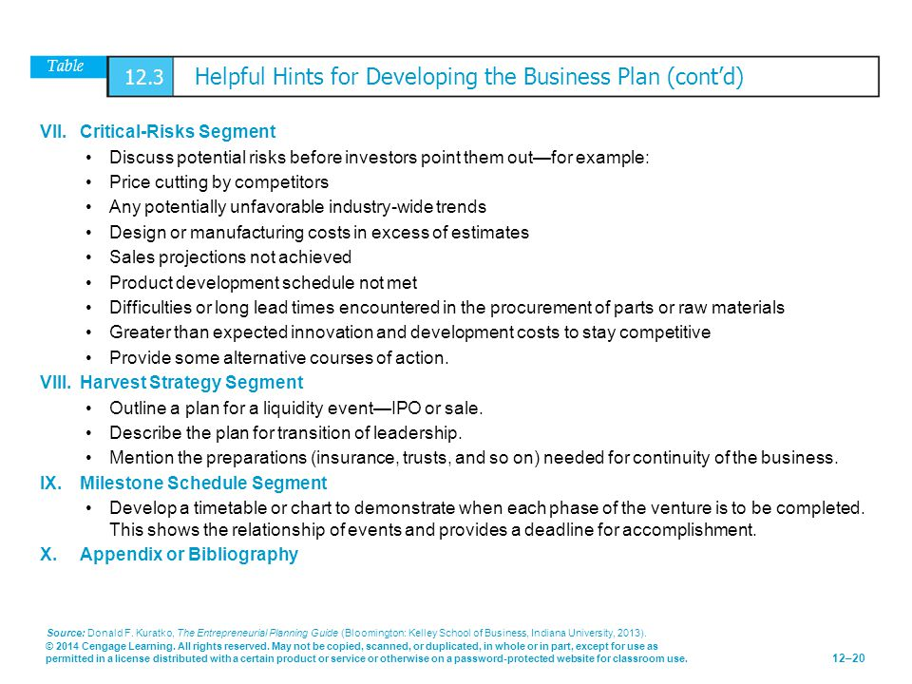

Slide 41
Guide Lines for writing a business plan (it is important to be sensitive to the structure, content and style of a business plan before sending it to an investor or anyone else who may involved with the new firm)
Structure of the business plan
Departing from the basic structure (outline) of the conventional business plan format is usually a mistake.
Investors are very busy people and want a plan where they can easily find critical information.
Content of the business plan
Clear and concise information on all important aspects.
25 to 35 pages.
Business plan is ready then make sure that no critical information has been omitted.
Don’t miss information like
Significant industry trends
How much money the company needed
What the money was going to be used for
Contact information of the entrepreneur.
Style or format of the business plan
How long and detailed it should be ?
Depends on the type of the business plan.
Recognizing the Elements of the plan may change
New insights emerge when start getting feedback from others (so you may make changes in the business plan)
This process continues throughout the life of a company

Slide 42
Types of Business Plan (different rule of thumb regarding the length and level of detail)
Summary Business Plan
10 to 15 pages
New ventures in the early stages of development
Want to test the waters
To see if the investors are interested in their idea
Full Business Plan (focus of this chapter)
25 to 35 pages
Spells out the company’s operations and plans in much more detail than summary business plan
Works best for new ventures that are at the point where they need funding (serves as blueprint for the company operation)
Operational Business Plan
40 to 100 pages
Meant for the internal audience
Works best as a tool for creating a blueprint (providing guidance to ta operational managers)

Slide 43

What is a red flag ? “red flags are raised when certain aspects of a business plan are insufficient or miss the mark”
A red flag is a warning or an indicator of a potential problem or threat, such as any undesirable characteristic that stands out to an analyst as it pertains to a company's stock, financial statements, or news reports.

Slide 44
Red Flags in Business Plans
Founders with non of their own money at risk
A poorly cited plan
A plan should be built on hard evidence / sound research
No guesswork / what the entrepreneur thinks will happen
The sources for all primary / secondary research should be cited
Defining the market size too broadly
True market size is not well defined.
Market opportunity needs to be better defined
The new venture will target a segment / specific market within the industry.
Overly aggressive financials
Unrealistically optimistic lose credibility.
Well reasoned statements backed by sound research and judgment gain credibility quickly.
Sloppiness in any area
Balance sheets that are not balanced.

Slide 45
Updating the business plan
Financial changes.
Additional changes.
Changes in the markets.
Launch of a new product or service.
New management team.

Slide 46
What to do when a venture capitalist turns you down (Ten Questions)
Confirms the decision.
Sell for the future.
Find out why you were rejected.
Ask for advice.
Ask for suggestions.
Get the name.
Find out why.
Work on an introduction.
Develop a reasonable excuse (can I tell him that your decision to turn us down was based on __”
Know your referral (what will you tell him when he calls)

Slide 47


